Slide 1
CONIC SECTIONS, CYCLOIDS
UNIT-I

Slide 2
CONIC SECTIONS

Slide 3
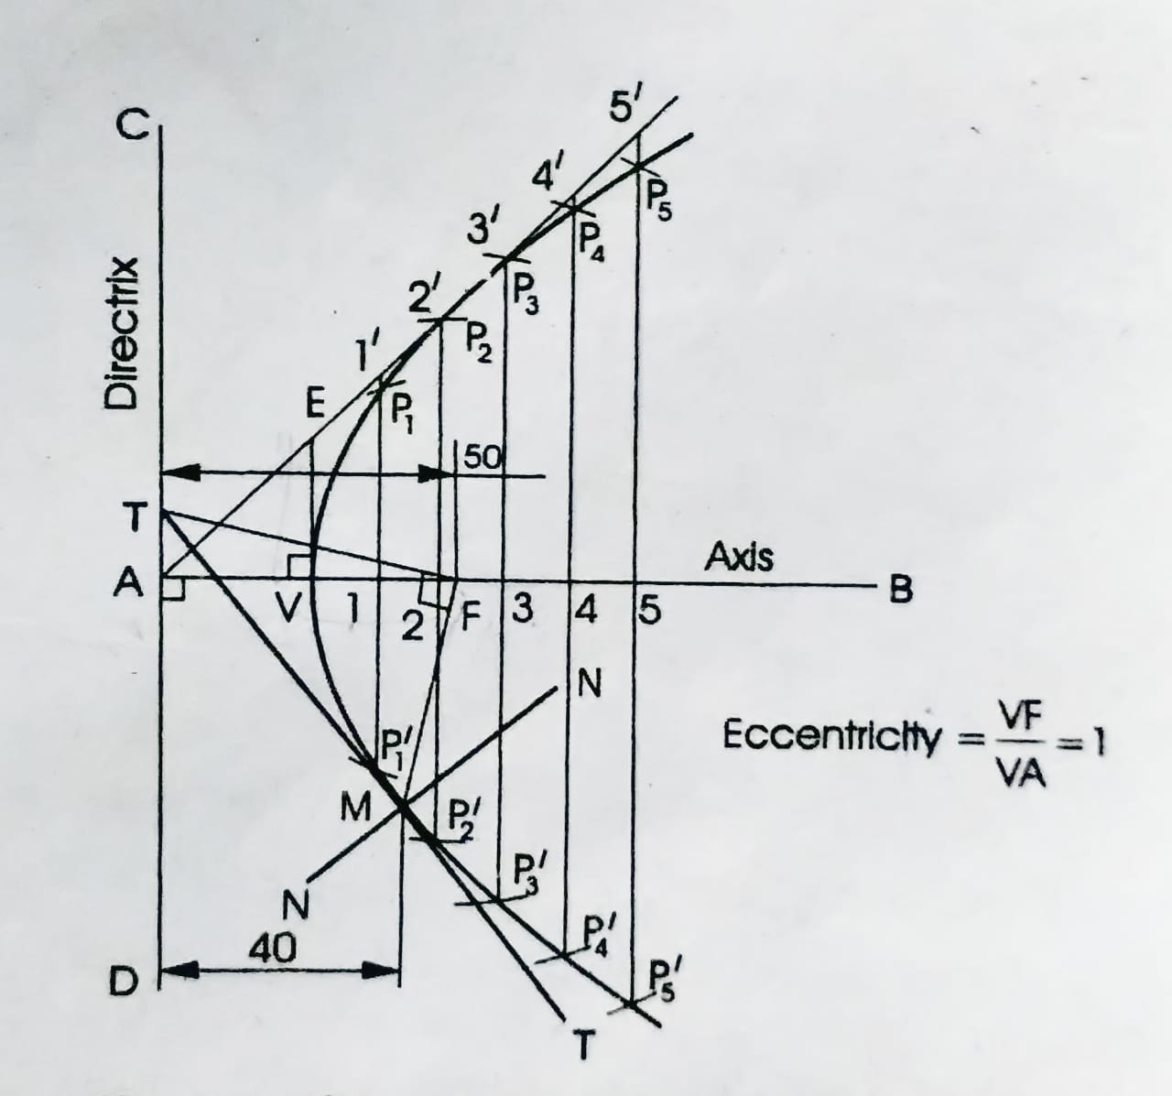
1. Construct a parabola, with the distance of the focus from the directrix as 50. Also, draw normal and tangent to the curve, at a point 40 from the directrix.

Slide 4
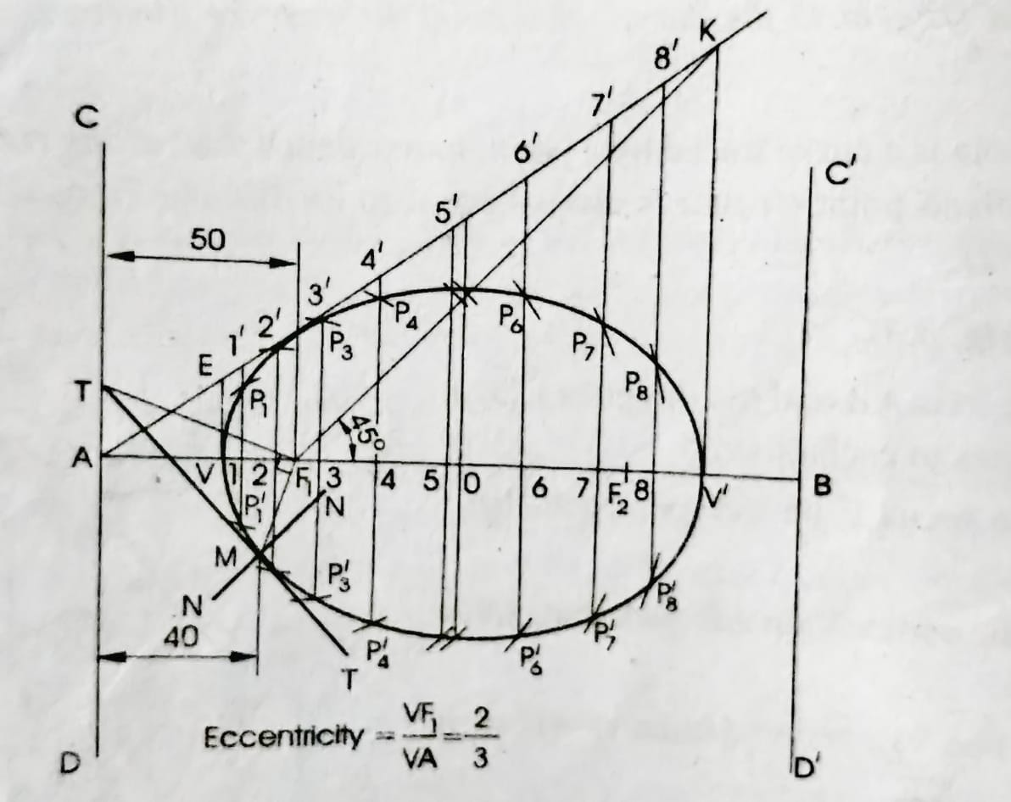
2. Construct a: ellipse, with distance of the focus from the directrix as 50 and eccentricity as 2/3. Also, draw normal and tangent to the curve at a point 40 from the directrix.

Slide 5
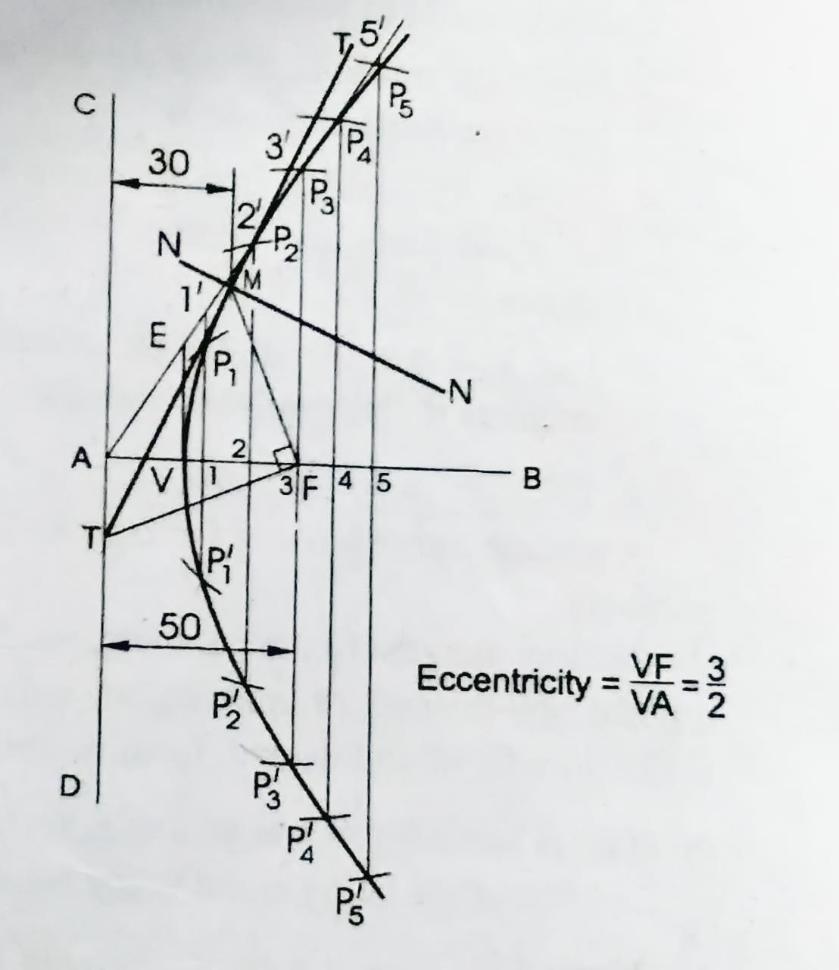
3. Construct a hyperbola, with the distance between the focus and the directrix as 50 and eccentricity as 3/2. Also, draw normal and tangent to the curve at a point 30 from the directrix.

Slide 6
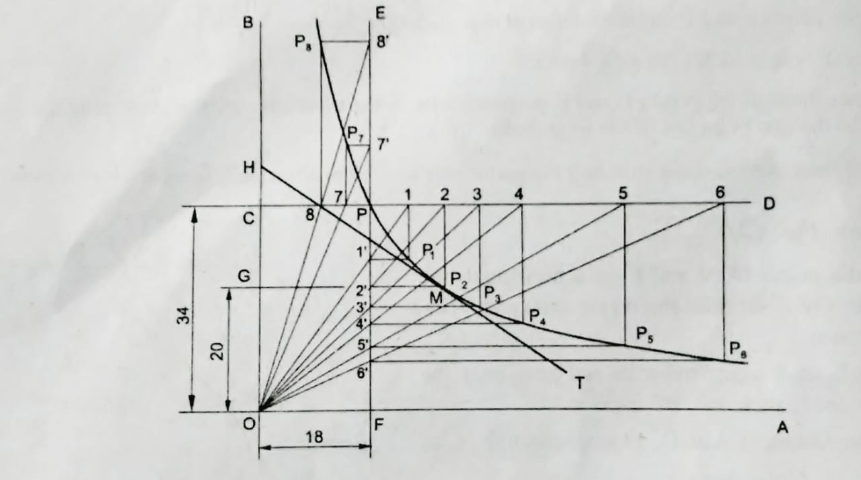
4. Construct a rectangular hyperbola, when a point P on it is at distances of 18 and 34from two asymptotes. Also, draw a tangent to the curve at a point 20 from an asymptote.

Slide 7
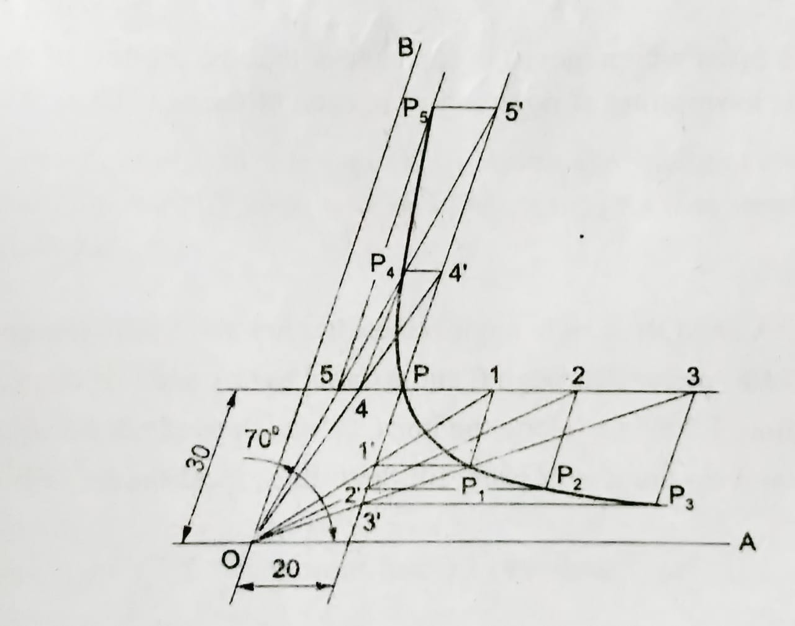
5. The asymptotes of a hyperbola are inclined at 70° to each other. Construct the curve when a point P on it is at distances of 20 and 30 from the two asymptotes.

Slide 8
cycloids

Slide 9
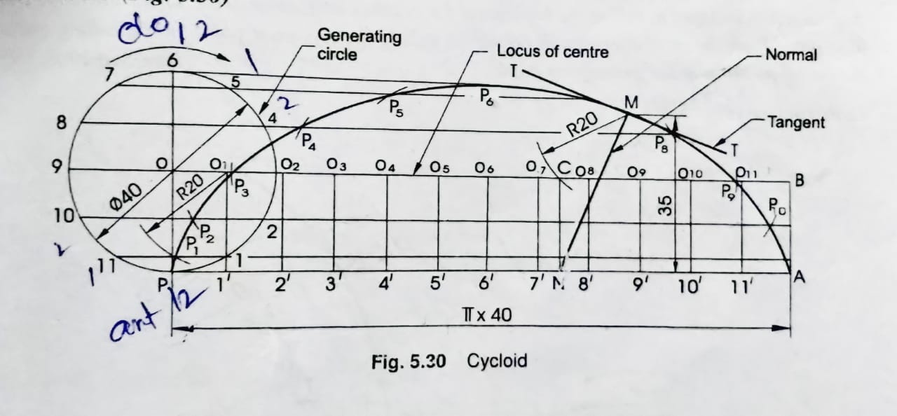
6. Construct a cycloid, given the diameter of the generating circle as 40. Draw tangent to the curve at a point on it, 35 from the line.

Slide 10
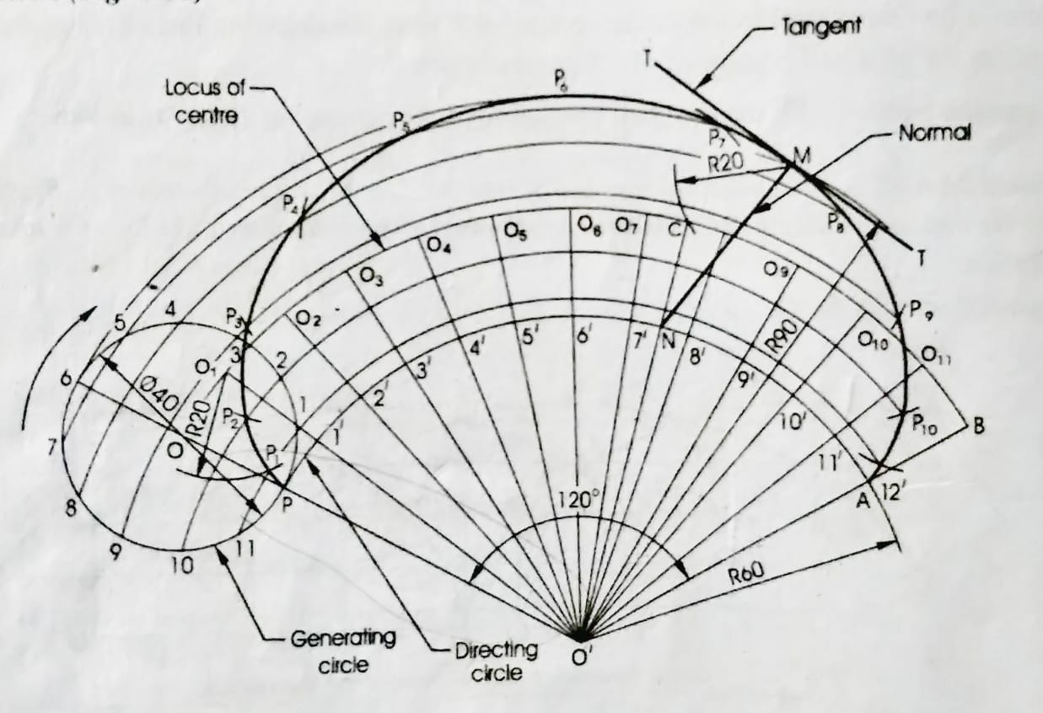
7. Draw an epi-cycloid of a circle of 40 diameter, which rolls on another circle of 120 diameter for one revolution clock-wise. Draw a tangent and a normal to it at a point 90 from the centre of the directing circle.

Slide 11
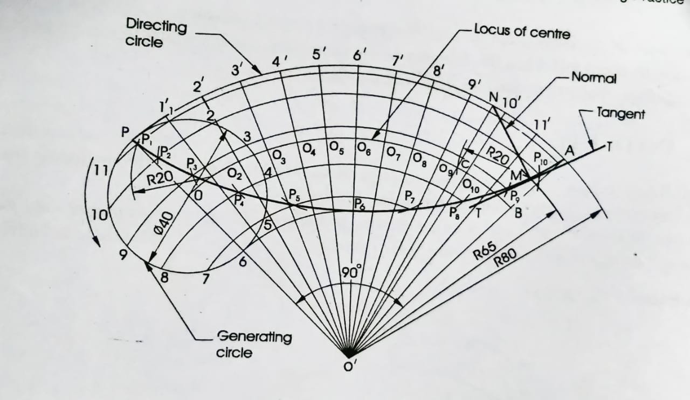
8. Draw, a hypo-cycloid of a circle of 40 diameter which rolls inside another circle of 160 diameter, for one revolution counter clock-wise. Draw a tangent and a normal to it at a point 65 from the centre of the directing circle.

Slide 12
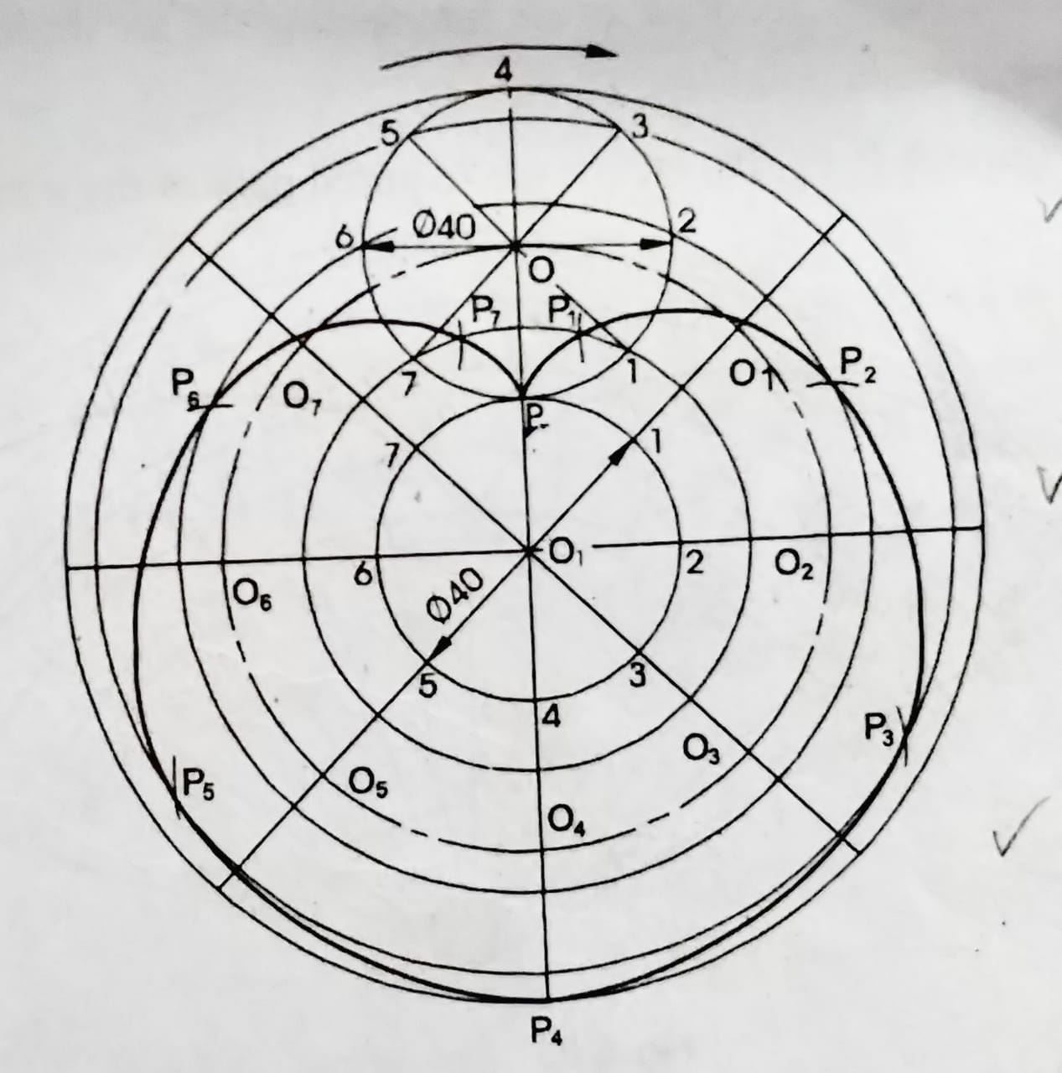
9. Draw the epi-cycloid of a circle of 40mm diameter which rolls outside of another circle of 40 mm diameter for one revolution clockwise?

Slide 13
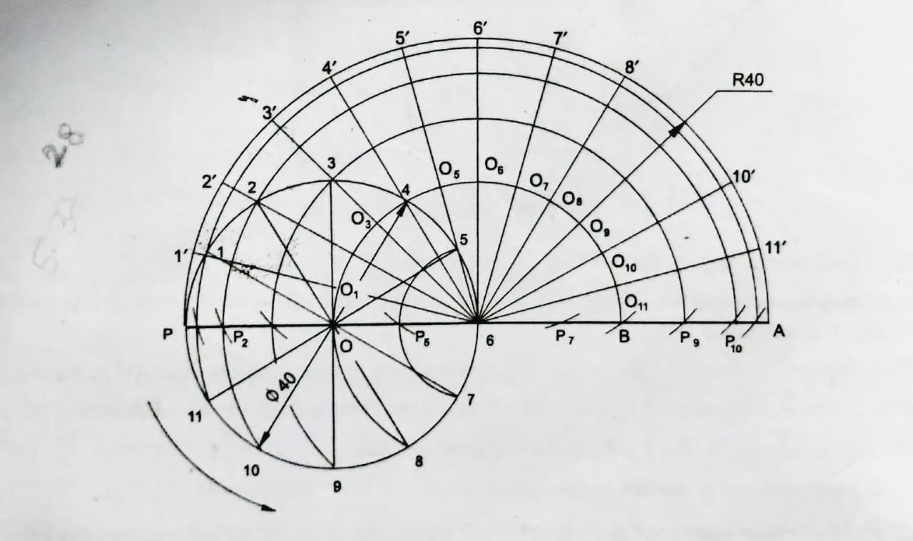
10. Show by means of a drawing that when the diameter of the directing circle is twice that of the generating circle, the hypo-cycloid is a straight line. Take the diameter of the generating circle equal to 40.

